Slide 1
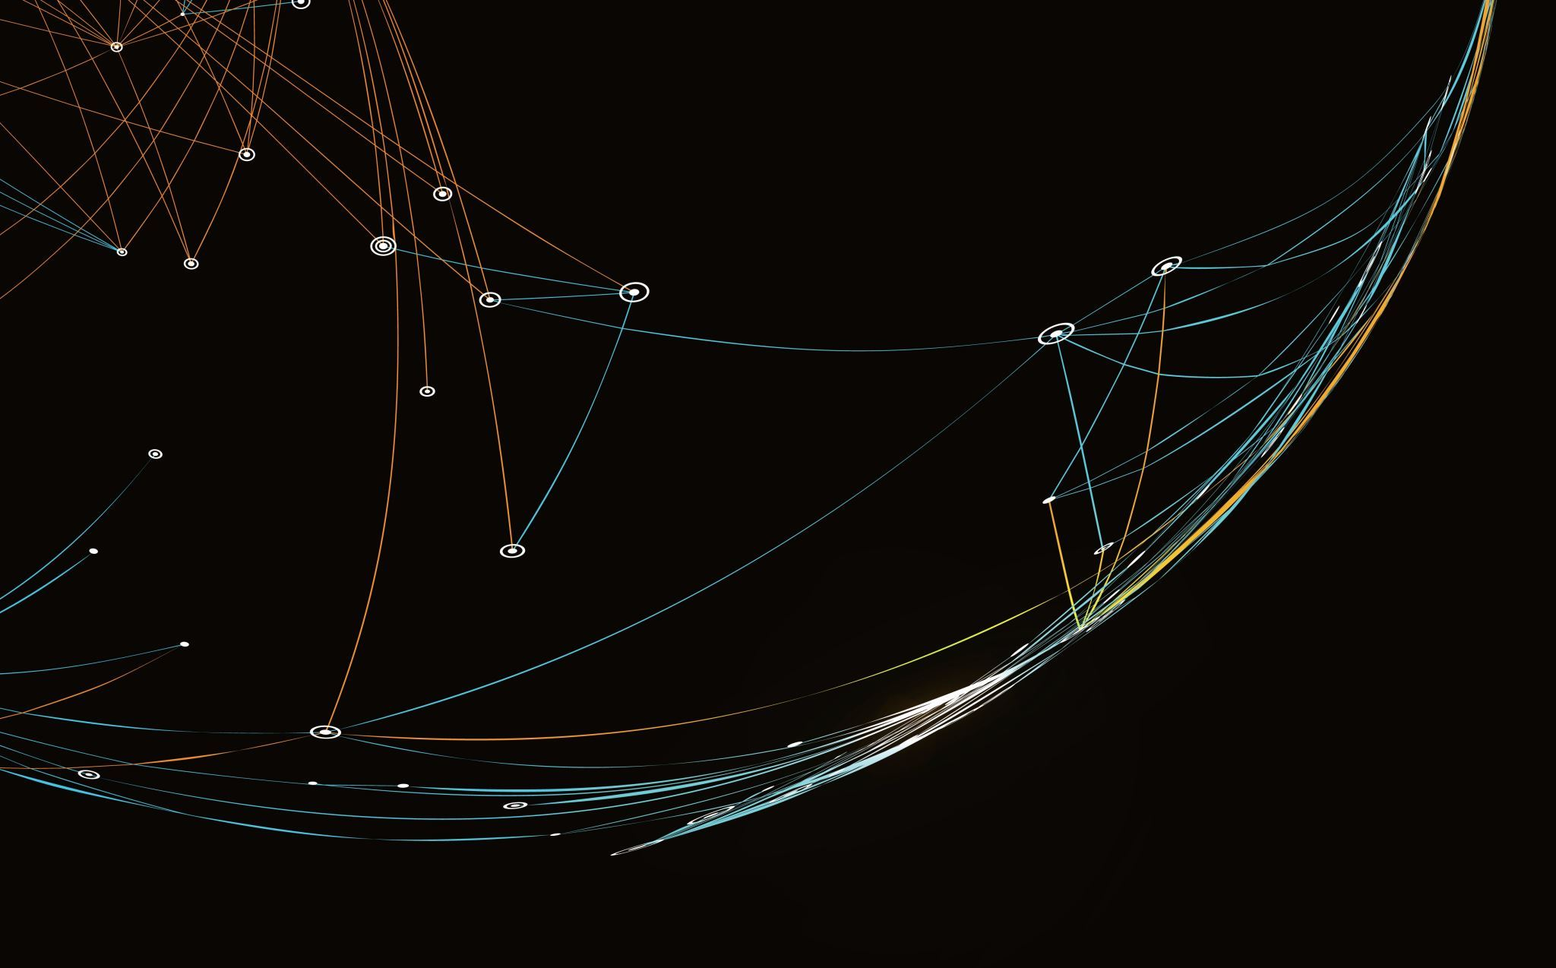
BookMe
Josh Lohner, Seth Beesley, Prosper Jibunor
1

Slide 2
Weekly Risk Management
Working on Business Presentation
Spring Break
Team Had a Week Off
2

Slide 3
Iteration Lines of Code
Josh Lohner (Front-End): 0
Seth Beesley(Back-End): 0
Prosper(Tests): 0
TLOC: 661
3

Slide 4
Test Coverage & Burndown Rate
Test Coverage: 100%
Burndown Rate: 100%
4

Slide 5
Test Coverage & Burndown Rate (Overall)
Seth: 1 of 10 (Features)
Josh: 4 of 13 (Features)
Prosper: 1 of 10 (tests)
5

Slide 6
Test Coverage & Burndown Rate (Iteration)
Seth: 1 of 0 (Features)
Josh: 0 of 0
Prosper: 0 of 0
5

Slide 7
Current Milestones
Create/Finish concrete version of Login (Front-End)
Create/Finish concrete version of Login Database & Finish setting up Firebase (Back-End)
6

Slide 8
Future Milestones
Create a usable messaging system (Front-End)
Finish on the Firebase Messaging system (Back-End)
7

